Slide 1

C# Advanced – Class3
Trainer: Marjan Pushev
Assistant: Dejan Blazheski
Code academy @ Skopje, 2019

Slide 2
Agenda
Nested classes
Static classes
Partial classes
Partial methods
Extension methods

Slide 3
Nested classes
The nested classes are created within the code block of other classes. They behave the same way as the other classes.
All rules said for the classes so far are also valid for the nested classes – at the end of the day a nested class is basically a class.
Nested class is by default private.
Access modifiers: public, private, protected, internal (not just normally used public and internal).
Outer/Containing class is not allowed to access inner class members.
We are allowed to create objects of nested class in outer class.
Nested class can access static member declared in outer class.

Slide 4
Nested classes
Practical usage:
Nested classes can access private members of the outer class.
Nested classes can be private which ensures the concept of encapsulation.
But, how can we structure our class relations on different way…? ☺
Demo

Slide 5
Static classes
static – reserved word.
Cannot instantiate an object of a static class (cannot use the new keyword to create a variable of the class type).
All methods and properties must be static.
We access the members of a static class by using the class name itself.
A static class is a sealed class which means it cannot be inherited.
Demo example for sealed classes and members

Slide 6
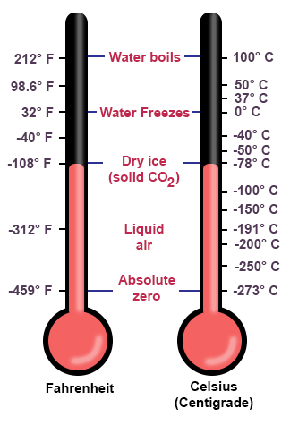
Static classes
Demo
Fahrenheit/ Celsius Converter application

Slide 7
Static classes
Practical usage:
As a convenient container for sets of methods that just operate on input parameters and do not have to get or set any internal instance fields.
.NET Framework example: System.Math
Cannot contain instance constructors, BUT can contain static constructors.
What do you think about static members? ☺
Exercise: Gallons to Litters Converter application (formula & implementation)

Slide 8
Partial classes and methods
partial – reserved word.
It is possible to split the definition of a class, struct or interface over two or more .cs files.
Usually needed when the class definition is big so it’s better to have the definition split into multiple files (which are combined in single file in compile time).
Every part of the partial class definition should be in the same assembly and namespace, but you can use different source file name.
Every part of the partial class definition should have the same accessibility like private, protected, etc.

Slide 9
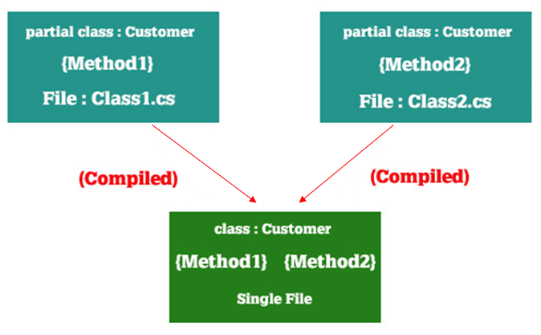
Partial classes and methods

Slide 10
Partial classes and methods
Partial methods:
Can have a method as a partial in multiple .cs files.
The method must be void type and with the partial keyword.
A partial method cannot have access modifiers (public, private,…).
Demo

Slide 11
Extension methods
Represent a special kind of static method that enable to "add" methods to existing types without creating a new derived type.
An extension method is created by adding a static method to a static class.
This first parameter is decorated with the keyword this.
Example: Think about sealed and String class in .NET Framework
Practical usage: LINQ (Language Integrated Query)
Demo
Exercise

Slide 12
Extension methods
Exercises
Exercise 1
Implement QuoteString extension method for returning input string as quoted
Exercise 2
Implement IsDigit extension method for returning bool result if input string is valid number
Exercise 3
Implement IsNumericType extension method for checking if input double value is from valid numeric type
Modify IsNumericType extension method to return the exact type of the input value
Implement IsNotNumericType extension method for checking if input double value is not from valid numeric type

